Slide 1
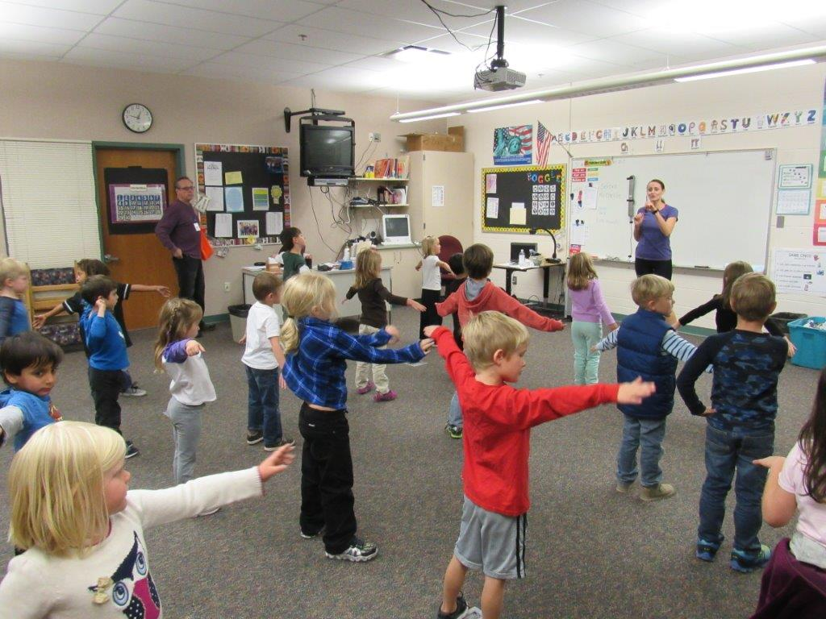
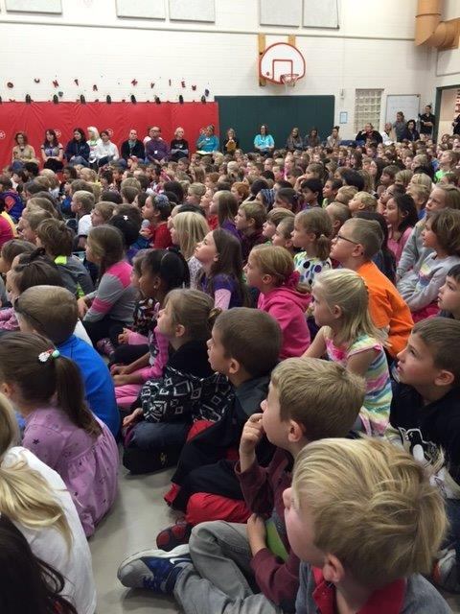
Write Now – Right Now Data Results
School’s Demographics:
Located in Colorado
Enrollment 600+ students
Over 25% of students from Military Families (high turnover)
Center based program for Students on the Autism Spectrum
15% of students identified with special needs
The following slides show 3 school years of data beginning with the most recent

Slide 2
2016-2017 5th Grade PARCC Scores
Interesting facts:
4 teachers in Grade 5
2 implemented Write Now - Right Now
2 implemented Write Now - Right Now, but did not follow all the lessons as written
The next few slides shows the overall ELA score for each particular teacher for the 2016-2017 testing year which includes the Reading and Writing scores combined
Test scores are then separated into the various categories for Reading and Writing
Reading categories: Literary, Informational, and Vocabulary
Writing: Written Expression and Language Conventions.

Slide 3
5th Grade Average Scores 2016-2017
5th Grade PARCC AVG | 5th Grade Colorado AVG | 5th Grade District AVG | 5th Grade School AVG
43% Meets/Exceeds | 46% Meets/Exceeds | 61% Meets/Exceeds | 79 % Meets/Exceeds
The data shows that the students at this school scored significantly higher than:
The PARCC National
The Colorado Average
The District Average

Slide 4
5th Grade PARCC ELA 2016-2017
Teacher A-Implemented Write Now - Right Now But Does Not Follow All the Lessons
ELA Classroom Overall Score Breakdown-Teacher A
5-Exceeded | 4-Met | 3-Approached | 2-Partially Met | 1-Did Not Meet
7% | 71% | 15% | 4% | 4%
Reading Literary Informational Vocabulary |  |  | Writing Expression Conventions
36% Below/Nearly 64% Meets/Exceeds | 36% Below/Nearly 64% Meets/Exceeds | 25% Below/Nearly 75% Meets/Exceeds | 36% Below/Nearly 69% Meets/Exceeds | 32% Below/Nearly 73% Meets/Exceeds
Teacher B-Implemented Write Now - Right Now
ELA Classroom Overall Score Breakdown-Teacher B
5-Exceeded | 4-Met | 3-Approached | 2-Partially Met | 1-Did Not Meet
25% | 63% | 4% | 4% | 4%
Reading Literary Informational Vocabulary |  |  | Writing Expression Conventions
29% Below/Nearly 71% Meets/Exceeds | 33% Below/Nearly 67% Meets/Exceeds | 42% Below/Nearly 58% Meets/Exceeds | 17% Below/Nearly 83% Meets/Exceeds | 21% Below/Nearly 79% Meets/Exceeds

Slide 5
5th Grade PARCC ELA 2016-2017
Teacher C- Uses Write Now - Right Now But Does Not Follow All the Lessons
ELA Classroom Overall Score Breakdown-Teacher C
5-Exceeded | 4-Met | 3-Approached | 2-Partially Met | 1-Did Not Meet
19% | 54% | 27% | 0% | 0%
Reading Literary Informational Vocabulary |  |  | Writing Expression Conventions
35% Below/Nearly 65% Meets/Exceeds | 35% Below/Nearly 65% Meets/Exceeds | 35% Below/Nearly 65% Meets/Exceeds | 31% Below/Nearly 69% Meets/Exceeds | 31% Below/Nearly 69% Meets/Exceeds
Teacher D-Uses Write Now - Right Now
ELA Classroom Overall Score Breakdown-Teacher D
5-Exceeded | 4-Met | 3-Approached | 2-Partially Met | 1-Did Not Meet
20% | 57% | 17% | 3% | 3%
Reading Literary Informational Vocabulary |  |  | Writing Expression Conventions
33% Below/Nearly 67% Meets/Exceeds | 33% Below/Nearly 67% Meets/Exceeds | 33% Below/Nearly 67% Meets/Exceeds | 20% Below/Nearly 80% Meets/Exceeds | 13% Below/Nearly 87% Meets/Exceeds

Slide 6
2015-2016 5th Grade PARCC Scores
Interesting facts:
3 teachers in Grade 5
2 implemented Write Now - Right Now
1 implemented portions of Write Now - Right Now, but did not follow many of the lessons as written
The next few slides shows the overall ELA score for that particular teacher for the 2016-2017 testing year which
includes the Reading and Writing scores combined
Test scores are then separated into the various categories for Reading and Writing
Reading categories: Literary, Informational, and Vocabulary
Writing: Written Expression and Language Conventions.

Slide 7
5th Grade Average Scores 2015-2016
5th Grade PARCC AVG | 5th Grade Colorado AVG | 5th Grade District AVG | 5th Grade School AVG
The data shows that the students at this school scored significantly higher than:
The PARCC National
The Colorado Average
The District Average

Slide 8
5th Grade PARCC ELA 2015-2016
Teacher A-Implemented Write Now - Right Now
ELA Classroom Overall Score Breakdown-Teacher A
5-Exceeded | 4-Met | 3-Approached | 2-Partially Met | 1-Did Not Meet
4% | 62% | 23% | 7% | 4%
Reading Literary Informational Vocabulary |  |  | Writing Expression Conventions
42% Below/Nearly 58% Meets/Exceeds | 38% Below/Nearly 62% Meets/Exceeds | 46% Below/Nearly 54% Meets/Exceeds | 19% Below/Nearly 81% Meets/Exceeds | 31% Below/Nearly 69% Meets/Exceeds
Teacher B-Implemented Parts of Write Now - Right Now
ELA Classroom Overall Score Breakdown-Teacher B
5-Exceeded | 4-Met | 3-Approached | 2-Partially Met | 1-Did Not Meet
4% | 59% | 26% | 7% | 4%
Reading Literary Informational Vocabulary |  |  | Writing Expression Conventions
37% Below/Nearly 63% Meets/Exceeds | 48% Below/Nearly 52% Meets/Exceeds | 41% Below/Nearly 59% Meets/Exceeds | 37% Below/Nearly 63% Meets/Exceeds | 41% Below/Nearly 59% Meets/Exceeds

Slide 9
5th Grade PARCC ELA 2015-2016
Teacher C-Implemented Write Now- Right Now
ELA Classroom Overall Score Breakdown-Teacher C
5-Exceeded | 4-Met | 3-Approached | 2-Partially Met | 1-Did Not Meet
19% | 46% | 23% | 8% | 4%
Reading Literary Informational Vocabulary |  |  | Writing Expression Conventions
35% Below/Nearly 65% Meets/Exceeds | 38% Below/Nearly 62% Meets/Exceeds | 46% Below/Nearly 54% Meets/Exceeds | 27% Below/Nearly 79% Meets/Exceeds | 23% Below/Nearly 77% Meets/Exceeds

Slide 10
2014-2015 5th Grade PARCC Scores (Year 1)
(Write Now – Right Now Pilot Year)
Interesting facts:
4 teachers in grade 5
2 implemented Write Now - Right Now
2 implemented many of the Write Now - Right Now
The next few slides shows the overall ELA score for that particular teacher for the 2016-2017 testing year which
includes the Reading and Writing scores combined
Test scores are then separated into the various categories for Reading and Writing
Reading categories: Literary, Informational, and Vocabulary
Writing: Written Expression and Language Conventions.

Slide 11
5th Grade Average Scores 2014-2015
(Write Now – Right Now Pilot Year)
5th Grade PARCC AVG | 5th Grade Colorado AVG | 5th Grade District AVG | 5th Grade School AVG
The data shows that the students at this school scored significantly higher than:
The PARCC National
The Colorado Average
The District Average

Slide 12
5th Grade PARCC ELA 2014-2015
Teacher A-Implemented Many of the Lessons in Write Now - Right Now
ELA Classroom Overall Score Breakdown-Teacher A
5-Exceeded | 4-Met | 3-Approached | 2-Partially Met | 1-Did Not Meet
5% | 74% | 16% | 5% | 0%
Reading Literary Informational Vocabulary |  |  | Writing Expression Conventions
21% Below/Nearly 79% Meets/Exceeds | 32% Below/Nearly 68% Meets/Exceeds | 26% Below/Nearly 74% Meets/Exceeds | 31% Below/Nearly 69% Meets/Exceeds | 16% Below/Nearly 84% Meets/Exceeds
Teacher B-Implemented Many of the Lessons in Write Now - Right Now
ELA Classroom Overall Score Breakdown-Teacher B
5-Exceeded | 4-Met | 3-Approached | 2-Partially Met | 1-Did Not Meet
17% | 38% | 33% | 12% | 0%
Reading Literary Informational Vocabulary |  |  | Writing Expression Conventions
38% Below/Nearly 62% Meets/Exceeds | 42% Below/Nearly 58% Meets/Exceeds | 42% Below/Nearly 48% Meets/Exceeds | 33% Below/Nearly 67% Meets/Exceeds | 21% Below/Nearly 79% Meets/Exceeds

Slide 13
5th Grade PARCC ELA 2014-2015
Teacher C-Implemented Write Now - Right Now
ELA Classroom Overall Score Breakdown-Teacher C
5-Exceeded | 4-Met | 3-Approached | 2-Partially Met | 1-Did Not Meet
4% | 67% | 15% | 11% | 4%
Reading Literary Informational Vocabulary |  |  | Writing Expression Conventions
26% Below/Nearly 74% Meets/Exceeds | 37% Below/Nearly 63% Meets/Exceeds | 48% Below/Nearly 52% Meets/Exceeds | 26% Below/Nearly 74% Meets/Exceeds | 19% Below/Nearly 81% Meets/Exceeds
Teacher D-Implemented Write Now - Right Now
ELA Classroom Overall Score Breakdown-Teacher D
5-Exceeded | 4-Met | 3-Approached | 2-Partially Met | 1-Did Not Meet
4% | 64% | 16% | 12% | 4%
Reading Literary Informational Vocabulary |  |  | Writing Expression Conventions
48% Below/Nearly 52% Meets/Exceeds | 40% Below/Nearly 60% Meets/Exceeds | 32% Below/Nearly 68% Meets/Exceeds | 24% Below/Nearly 76% Meets/Exceeds | 16% Below/Nearly 84% Meets/Exceeds

Slide 14
2016-2017 3rd Grade PARCC Scores
Interesting facts:
4 teachers in grade 4
3 implemented Write Now - Right Now
1 implemented Write Now - Right Now, but did not follow all the lessons as written
The next few slides shows the overall ELA score for that particular teacher for the 2016-2017 testing year which
includes the Reading and Writing scores combined
Test scores are then separated into the various categories in reading and writing that students received test scores
Reading categories: Literary, Informational, and Vocabulary
Writing: Written Expression and Language Conventions.

Slide 15
3rd Grade Average Scores 2016-2017
3rd Grade PARCC AVG | 3rd Grade Colorado AVG | 3rd Grade District AVG | 3rd Grade School AVG
40% Meets/Exceeds | 40% Meets/Exceeds | 57% Meets/Exceeds | 75 % Meets/Exceeds
The data shows that the students at this school scored significantly higher than:
The PARCC National
The Colorado Average
The District Average

Slide 16
3rd Grade PARCC ELA 2016-2017
Teacher A-Implemented Write Now - Right Now
ELA Classroom Overall Score Breakdown-Teacher A
5-Exceeded | 4-Met | 3-Approached | 2-Partially Met | 1-Did Not Meet
29% | 59% | 4% | 4% | 4%
Reading Literary Informational Vocabulary |  |  | Writing Expression Conventions
30% Below/Nearly 70% Meets/Exceeds | 19% Below/Nearly 81% Meets/Exceeds | 26% Below/Nearly 74% Meets/Exceeds | 15% Below/Nearly 85% Meets/Exceeds | 11% Below/Nearly 89% Meets/Exceeds
Teacher B-Implemented Write Now - Right Now 3 Times a Week
ELA Classroom Overall Score Breakdown-Teacher B
5-Exceeded | 4-Met | 3-Approached | 2-Partially Met | 1-Did Not Meet
18% | 41% | 30% | 11% | 0%
Reading Literary Informational Vocabulary |  |  | Writing Expression Conventions
44% Below/Nearly 56% Meets/Exceeds | 33% Below/Nearly 67% Meets/Exceeds | 33% Below/Nearly 67% Meets/Exceeds | 30% Below/Nearly 70% Meets/Exceeds | 26% Below/Nearly 74% Meets/Exceeds

Slide 17
3rd Grade PARCC ELA 2016-2017
Teacher C-Implemented Write Now - Right Now
ELA Classroom Overall Score Breakdown-Teacher C
5-Exceeded | 4-Met | 3-Approached | 2-Partially Met | 1-Did Not Meet
18% | 63% | 15% | 4% | 0%
Reading Literary Informational Vocabulary |  |  | Writing Expression Conventions
48% Below/Nearly 52% Meets/Exceeds | 41% Below/Nearly 59% Meets/Exceeds | 37% Below/Nearly 63% Meets/Exceeds | 15% Below/Nearly 85% Meets/Exceeds | 7% Below/Nearly 93% Meets/Exceeds
Teacher D-Implemented Write Now - Right Now
ELA Classroom Overall Score Breakdown-Teacher D
5-Exceeded | 4-Met | 3-Approached | 2-Partially Met | 1-Did Not Meet
15% | 55% | 19% | 7% | 4%
Reading Literary Informational Vocabulary |  |  | Writing Expression Conventions
19% Below/Nearly 81% Meets/Exceeds | 30% Below/Nearly 70% Meets/Exceeds | 41% Below/Nearly 59% Meets/Exceeds | 30% Below/Nearly 76% Meets/Exceeds | 19% Below/Nearly 81% Meets/Exceeds

Slide 18
2015-2016 3rd Grade PARCC Scores
Interesting facts:
4 teachers in the grade level
2 implemented Write Now - Right Now
2 did not implement Write Now - Right Now
The next few slides shows the overall ELA score for that particular teacher for the 2016-2017 testing year which
includes the Reading and Writing scores combined
Test scores are then separated into the various categories in reading and writing that students received test scores
Reading categories: Literary, Informational, and Vocabulary
Writing: Written Expression and Language Conventions.

Slide 19
3rd Grade Average Scores 2015-2016
3rd Grade PARCC AVG | 3rd Grade Colorado AVG | 3rd Grade District AVG | 3rd Grade School AVG
The data shows that the students at this school scored significantly higher than:
The PARCC National
The Colorado Average
The District Average

Slide 20
3rd Grade PARCC ELA 2015-2016
Teacher A-Did Not Implement Write Now - Right Now
ELA Classroom Overall Score Breakdown-Teacher A
5-Exceeded | 4-Met | 3-Approached | 2-Partially Met | 1-Did Not Meet
8% | 48% | 16% | 20% | 8%
Reading Literary Informational Vocabulary |  |  | Writing Expression Conventions
48% Below/Nearly 52% Meets/Exceeds | 44% Below/Nearly 56% Meets/Exceeds | 40% Below/Nearly 60% Meets/Exceeds | 48% Below/Nearly 52% Meets/Exceeds | 28% Below/Nearly 72% Meets/Exceeds
Teacher B-Did Not Implement Write Now - Right Now
ELA Classroom Overall Score Breakdown-Teacher B
5-Exceeded | 4-Met | 3-Approached | 2-Partially Met | 1-Did Not Meet
0% | 30% | 50% | 20% | 0%
Reading Literary Informational Vocabulary |  |  | Writing Expression Conventions
60% Below/Nearly 40% Meets/Exceeds | 70% Below/Nearly 30% Meets/Exceeds | 80% Below/Nearly 20% Meets/Exceeds | 50% Below/Nearly 50% Meets/Exceeds | 50% Below/Nearly 50% Meets/Exceeds

Slide 21
3rd Grade PARCC ELA 2015-2016
Teacher C-Implemented Write Now - Right Now
ELA Classroom Overall Score Breakdown-Teacher C
5-Exceeded | 4-Met | 3-Approached | 2-Partially Met | 1-Did Not Meet
25% | 46% | 21% | 8% | 0%
Reading Literary Informational Vocabulary |  |  | Writing Expression Conventions
42% Below/Nearly 58% Meets/Exceeds | 29% Below/Nearly 71% Meets/Exceeds | 54% Below/Nearly 46% Meets/Exceeds | 25% Below/Nearly 75% Meets/Exceeds | 8% Below/Nearly 92% Meets/Exceeds
Teacher D-Implemented Write Now - Right Now
ELA Classroom Overall Score Breakdown-Teacher D
5-Exceeded | 4-Met | 3-Approached | 2-Partially Met | 1-Did Not Meet
26% | 52% | 11% | 0% | 11%
Reading Literary Informational Vocabulary |  |  | Writing Expression Conventions
44% Below/Nearly 56% Meets/Exceeds | 37% Below/Nearly 63% Meets/Exceeds | 44% Below/Nearly 56% Meets/Exceeds | 19% Below/Nearly 81% Meets/Exceeds | 11% Below/Nearly 89% Meets/Exceeds

Slide 22
2014-2015 3rd Grade PARCC Scores (Year 1)
(Write Now – Right Now Pilot Year)
Interesting facts:
4 teachers in the grade level
2 implemented many of the lessons in Write Now - Right Now
1 implemented Write Now – Right Now
2 Did not implement Write Now - Right Now
The next few slides shows the overall ELA score for that particular teacher for the 2016-2017 testing year which
includes the Reading and Writing scores combined
Test scores are then separated into the various categories in reading and writing that students received test scores
Reading categories: Literary, Informational, and Vocabulary
Writing: Written Expression and Language Conventions.

Slide 23
3rd Grade Average Scores 2014-2015
(Write Now – Right Now Pilot Year)
3rd Grade PARCC AVG | 3rd Grade Colorado AVG | 3rd Grade District AVG | 3rd Grade School AVG
The data shows that the students at this school scored significantly higher than:
The PARCC National
The Colorado Average
The District Average

Slide 24
3rd Grade PARCC ELA 2014-2015
Teacher A-Implemented Many Lessons of Write Now - Right Now
ELA Classroom Overall Score Breakdown-Teacher A
5-Exceeded | 4-Met | 3-Approached | 2-Partially Met | 1-Did Not Meet
8% | 48% | 28% | 12% | %
Reading Literary Informational Vocabulary |  |  | Writing Expression Conventions
44% Below/Nearly 56% Meets/Exceeds | 40% Below/Nearly 60% Meets/Exceeds | 44% Below/Nearly 56% Meets/Exceeds | 40% Below/Nearly 60% Meets/Exceeds | 24% Below/Nearly 76% Meets/Exceeds
Teacher B-Did Not Implement Write Now - Right Now
ELA Classroom Overall Score Breakdown-Teacher B
5-Exceeded | 4-Met | 3-Approached | 2-Partially Met | 1-Did Not Meet
8% | 52% | 20% | 12% | 8%
Reading Literary Informational Vocabulary |  |  | Writing Expression Conventions
24% Below/Nearly 56% Meets/Exceeds | 36% Below/Nearly 64% Meets/Exceeds | 48% Below/Nearly 52% Meets/Exceeds | 55% Below/Nearly 45% Meets/Exceeds | 46% Below/Nearly 54% Meets/Exceeds

Slide 25
3rd Grade PARCC ELA 2014-2015
Teacher C-Implemented Many Lessons in Write Now - Right Now
ELA Classroom Overall Score Breakdown-Teacher C
5-Exceeded | 4-Met | 3-Approached | 2-Partially Met | 1-Did Not Meet
8% | 36% | 24% | 20% | 12%
Reading Literary Informational Vocabulary |  |  | Writing Expression Conventions
60% Below/Nearly 40% Meets/Exceeds | 52% Below/Nearly 48% Meets/Exceeds | 36% Below/Nearly 64% Meets/Exceeds | 40% Below/Nearly 60% Meets/Exceeds | 35% Below/Nearly 65% Meets/Exceeds
Teacher D-Implemented Write Now - Right Now
ELA Classroom Overall Score Breakdown-Teacher D
5-Exceeded | 4-Met | 3-Approached | 2-Partially Met | 1-Did Not Meet
4% | 48% | 27% | 17% | 4%
Reading Literary Informational Vocabulary |  |  | Writing Expression Conventions
57% Below/Nearly 43% Meets/Exceeds | 65% Below/Nearly 35% Meets/Exceeds | 52% Below/Nearly 48% Meets/Exceeds | 25% Below/Nearly 75% Meets/Exceeds | 22% Below/Nearly 78%Meets/Exceeds

Slide 26
2016-2017 4th Grade PARCC Scores
Interesting facts:
3 teachers in 4th grade
3 implemented Write Now - Right Now
The next few slides shows the overall ELA score for that particular teacher for the 2016-2017 testing year which
includes the Reading and Writing scores combined
Test scores are then separated into the various categories in Reading and Writing
Reading categories: Literary, Informational, and Vocabulary
Writing: Written Expression and Language Conventions.

Slide 27
4th Grade Average Scores 2016-2017
4th Grade PARCC AVG | 4th Grade Colorado AVG | 4th Grade District AVG | 4th Grade School AVG
43% Meets/Exceeds | 44% Meets/Exceeds | 57% Meets/Exceeds | 81 % Meets/Exceeds
The data shows that the students at this school scored significantly higher than:
The PARCC National
The Colorado Average
The District Average

Slide 28
4th Grade PARCC ELA 2016-2017
Teacher A-Implemented Write Now - Right Now
ELA Classroom Overall Score Breakdown-Teacher A
5-Exceeded | 4-Met | 3-Approached | 2-Partially Met | 1-Did Not Meet
46% | 39% | 4% | 7% | 4%
Reading Literary Informational Vocabulary |  |  | Writing Expression Conventions
19% Below/Nearly 81% Meets/Exceeds | 27% Below/Nearly 73% Meets/Exceeds | 15% Below/Nearly 85% Meets/Exceeds | 15% Below/Nearly 85% Meets/Exceeds | 15% Below/Nearly 85% Meets/Exceeds
Teacher B-Implemented Write Now - Right Now
ELA Classroom Overall Score Breakdown-Teacher B
5-Exceeded | 4-Met | 3-Approached | 2-Partially Met | 1-Did Not Meet
33% | 44% | 19% | 4% | 0%
Reading Literary Informational Vocabulary |  |  | Writing Expression Conventions
30% Below/Nearly 70% Meets/Exceeds | 37% Below/Nearly 63% Meets/Exceeds | 33% Below/Nearly 67% Meets/Exceeds | 15% Below/Nearly 85% Meets/Exceeds | 15% Below/Nearly 85% Meets/Exceeds

Slide 29
4th Grade PARCC ELA 2016-2017
Teacher C-Implemented Write Now - Right Now
ELA Classroom Overall Score Breakdown-Teacher D
5-Exceeded | 4-Met | 3-Approached | 2-Partially Met | 1-Did Not Meet
22% | 59% | 15% | 4% | 0%
Reading Literary Informational Vocabulary |  |  | Writing Expression Conventions
41% Below/Nearly 59% Meets/Exceeds | 19% Below/Nearly 81% Meets/Exceeds | 52% Below/Nearly 48% Meets/Exceeds | 11% Below/Nearly 89% Meets/Exceeds | 15% Below/Nearly 85% Meets/Exceeds

Slide 30
2015-2016 4th Grade PARCC Scores
Interesting facts:
4 teachers in 4th grade
3 implemented Write Now - Right Now
1 did not implement Write Now - Right Now
The next few slides shows the overall ELA score for that particular teacher for the 2016-2017 testing year which
includes the Reading and Writing scores combined
Test scores are then separated into the various categories in Reading and Writing
Reading categories: Literary, Informational, and Vocabulary
Writing: Written Expression and Language Conventions.

Slide 31
4th Grade Average Scores 2015-2016
4th Grade PARCC AVG | 4th Grade Colorado AVG | 4th Grade District AVG | 4th Grade School AVG
The data shows that the students at this school scored significantly higher than:
The PARCC National
The Colorado Average
The District Average

Slide 32
4th Grade PARCC ELA 2015-2016
Teacher A – Did Not Implement Write Now – Right Now
ELA Classroom Overall Score Breakdown-Teacher A
5-Exceeded | 4-Met | 3-Approached | 2-Partially Met | 1-Did Not Meet
14% | 41% | 24% | 14% | 7%
Reading Literary Informational Vocabulary |  |  | Writing Expression Conventions
45% Below/Nearly 55% Meets/Exceeds | 55% Below/Nearly 45% Meets/Exceeds | 45% Below/Nearly 55% Meets/Exceeds | 41% Below/Nearly 59% Meets/Exceeds | 41% Below/Nearly 59% Meets/Exceeds
Teacher B – Implemented Write Now – Right Now
ELA Classroom Overall Score Breakdown-Teacher B
5-Exceeded | 4-Met | 3-Approached | 2-Partially Met | 1-Did Not Meet
44% | 40% | 8% | 4% | 4%
Reading Literary Informational Vocabulary |  |  | Writing Expression Conventions
36% Below/Nearly 64% Meets/Exceeds | 32% Below/Nearly 68% Meets/Exceeds | 52% Below/Nearly 48% Meets/Exceeds | 12% Below/Nearly 88% Meets/Exceeds | 12% Below/Nearly 88% Meets/Exceeds

Slide 33
4th Grade PARCC ELA 2015-2016
Teacher C – Implemented Write Now – Right Now
ELA Classroom Overall Score Breakdown-Teacher C
5-Exceeded | 4-Met | 3-Approached | 2-Partially Met | 1-Did Not Meet
33% | 41% | 4% | 11% | 11%
Reading Literary Informational Vocabulary |  |  | Writing Expression Conventions
41% Below/Nearly 59% Meets/Exceeds | 41% Below/Nearly 59% Meets/Exceeds | 52% Below/Nearly 48% Meets/Exceeds | 22% Below/Nearly 78% Meets/Exceeds | 26% Below/Nearly 74% Meets/Exceeds
Teacher D – Implemented Write Now – Right Now
ELA Classroom Overall Score Breakdown-Teacher D
5-Exceeded | 4-Met | 3-Approached | 2-Partially Met | 1-Did Not Meet
21% | 58% | 21% | 0% | 0%
Reading Literary Informational Vocabulary |  |  | Writing Expression Conventions
37% Below/Nearly 63% Meets/Exceeds | 37% Below/Nearly 63% Meets/Exceeds | 25% Below/Nearly 75% Meets/Exceeds | 17% Below/Nearly 83% Meets/Exceeds | 12% Below/Nearly 88% Meets/Exceeds

Slide 34
2014-2015 4th Grade PARCC Scores (Year 1)
(Write Now – Right Now Pilot Year)
Interesting facts:
3 teachers in 4th Grade
3 teachers implemented Write Now - Right Now
The next few slides shows the overall ELA score for that particular teacher for the 2016-2017 testing year which
includes the Reading and Writing scores combined
Test scores are then separated into the various categories in Reading and Writing
Reading categories: Literary, Informational, and Vocabulary
Writing: Written Expression and Language Conventions.

Slide 35
4th Grade Average Scores 2014-2015
(Write Now – Right Now Pilot Year)
4th Grade PARCC AVG | 4th Grade Colorado AVG | 4th Grade District AVG | 4th Grade School AVG
The data shows that the students at this school scored significantly higher than:
The PARCC National
The Colorado Average
The District Average

Slide 36
4th Grade PARCC ELA 2014-2015
Teacher A – Implemented Write Now – Right Now
ELA Classroom Overall Score Breakdown-Teacher A
5-Exceeded | 4-Met | 3-Approached | 2-Partially Met | 1-Did Not Meet
26% | 52% | 11% | 7% | 4%
Reading Literary Informational Vocabulary |  |  | Writing Expression Conventions
26% Below/Nearly 74% Meets/Exceeds | 30% Below/Nearly 70% Meets/Exceeds | 22% Below/Nearly 78% Meets/Exceeds | 30% Below/Nearly 70% Meets/Exceeds | 22% Below/Nearly 78% Meets/Exceeds
Teacher B – Implemented Write Now – Right Now
ELA Classroom Overall Score Breakdown-Teacher B
5-Exceeded | 4-Met | 3-Approached | 2-Partially Met | 1-Did Not Meet
4% | 62% | 23% | 4% | 8%
Reading Literary Informational Vocabulary |  |  | Writing Expression Conventions
46% Below/Nearly 54% Meets/Exceeds | 46% Below/Nearly 54% Meets/Exceeds | 42% Below/Nearly 62% Meets/Exceeds | 27% Below/Nearly 73% Meets/Exceeds | 23% Below/Nearly 77% Meets/Exceeds

Slide 37
4th Grade PARCC ELA 2014-2015
Teacher C – Implemented Write Now – Right Now
ELA Classroom Overall Score Breakdown-Teacher C
5-Exceeded | 4-Met | 3-Approached | 2-Partially Met | 1-Did Not Meet
36% | 41% | 18% | 5% | 0%
Reading Literary Informational Vocabulary |  |  | Writing Expression Conventions
32% Below/Nearly 68% Meets/Exceeds | 36% Below/Nearly 64% Meets/Exceeds | 18% Below/Nearly 82% Meets/Exceeds | 22% Below/Nearly 78% Meets/Exceeds | 20% Below/Nearly 80% Meets/Exceeds

